Slide 2
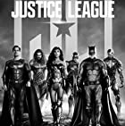









What Is the Best
Superhero Movie of 2021?
Poll

Slide 3
Poll

